Slide 1

Go, change the world
RV College of Engineering
Department of Chemistry
EXPERIENTIAL LEARNING PRESENTATION
Course : Engineering Chemistry (22CHY12A)
Topic :
PRECISION IRRIGATION
Submitted To :
DR. MAHESH R
DEPT. CHEMISTRY
RVCE

Slide 2

Go, change the world
RV College of
Engineering
Experiential Learning
Phase 1 and Phase 2: Presentation
CYCLE | CHEMISTRY CYCLE
BRANCH | COMPUTER SCIENCE ENGINEERING

Slide 3




TEAM INTRODUCTION
RV College of Engineering
Go, Change the World
Admission number | Name | Email Id | Mobile number
RVCE22BCS005 | KHUSHI GUPTA | khushigupta.cs22@rvce.edu.in | 9480005846
RVCE22BCS025 | KSHITHI RAMESH | kshithir.cs22@rvce.edu.in | 96066 21624
RVCE22BCS223 | MANASA S | manasas.cs22@rvce.edu.in | 87490 17446

Slide 4
Project title
PRECISION IRRIGATION

Slide 5

CONTENTS
RV College of Engineering
Go, Change the World
1. Introduction
2. Problem Survey
3. Literature Survey
4. Motivation
5. Objectives
6. Methodology
7. Timeline
8. References

Slide 6
RV College of Engineering
INTRODUCTION
Go, Change the World
Irrigation
Irrigation is the supply of water to crops by artificial means.
Smart irrigation
Smart irrigation systems tailor watering schedules and run times automatically to meet specific landscape needs.
Impact of Smart irrigation
Smart irrigation can save irrigation water and improve yield at the farm level, consequently leading to improved food security for the global population.
It is an advanced technology that contributes to water conservation, energy savings, soil stability, and cleaner water resources for wildlife.

Slide 7
RV College of Engineering
PROBLEM SURVEY
Go, Change the World
Loss of water- Traditional irrigation practices face the loss of water through seepage and lack of adequate extension services reduce its coverage and cause uneven distribution.
Staffing Shortages – Traditional irrigation practices face the problem of staffing shortage. Efficient and productive workers and cattle that are skilled in economical irrigation are necessary.
Wastage – Unregulated irrigation can lead to wastage of precious fresh water and can wash away the fertile top layer of soil, change the Ph of the soil, the important nutrients and fertilizers get wasted.
Waterlogging - Waterlogging is an issue on uneven land.

Slide 8
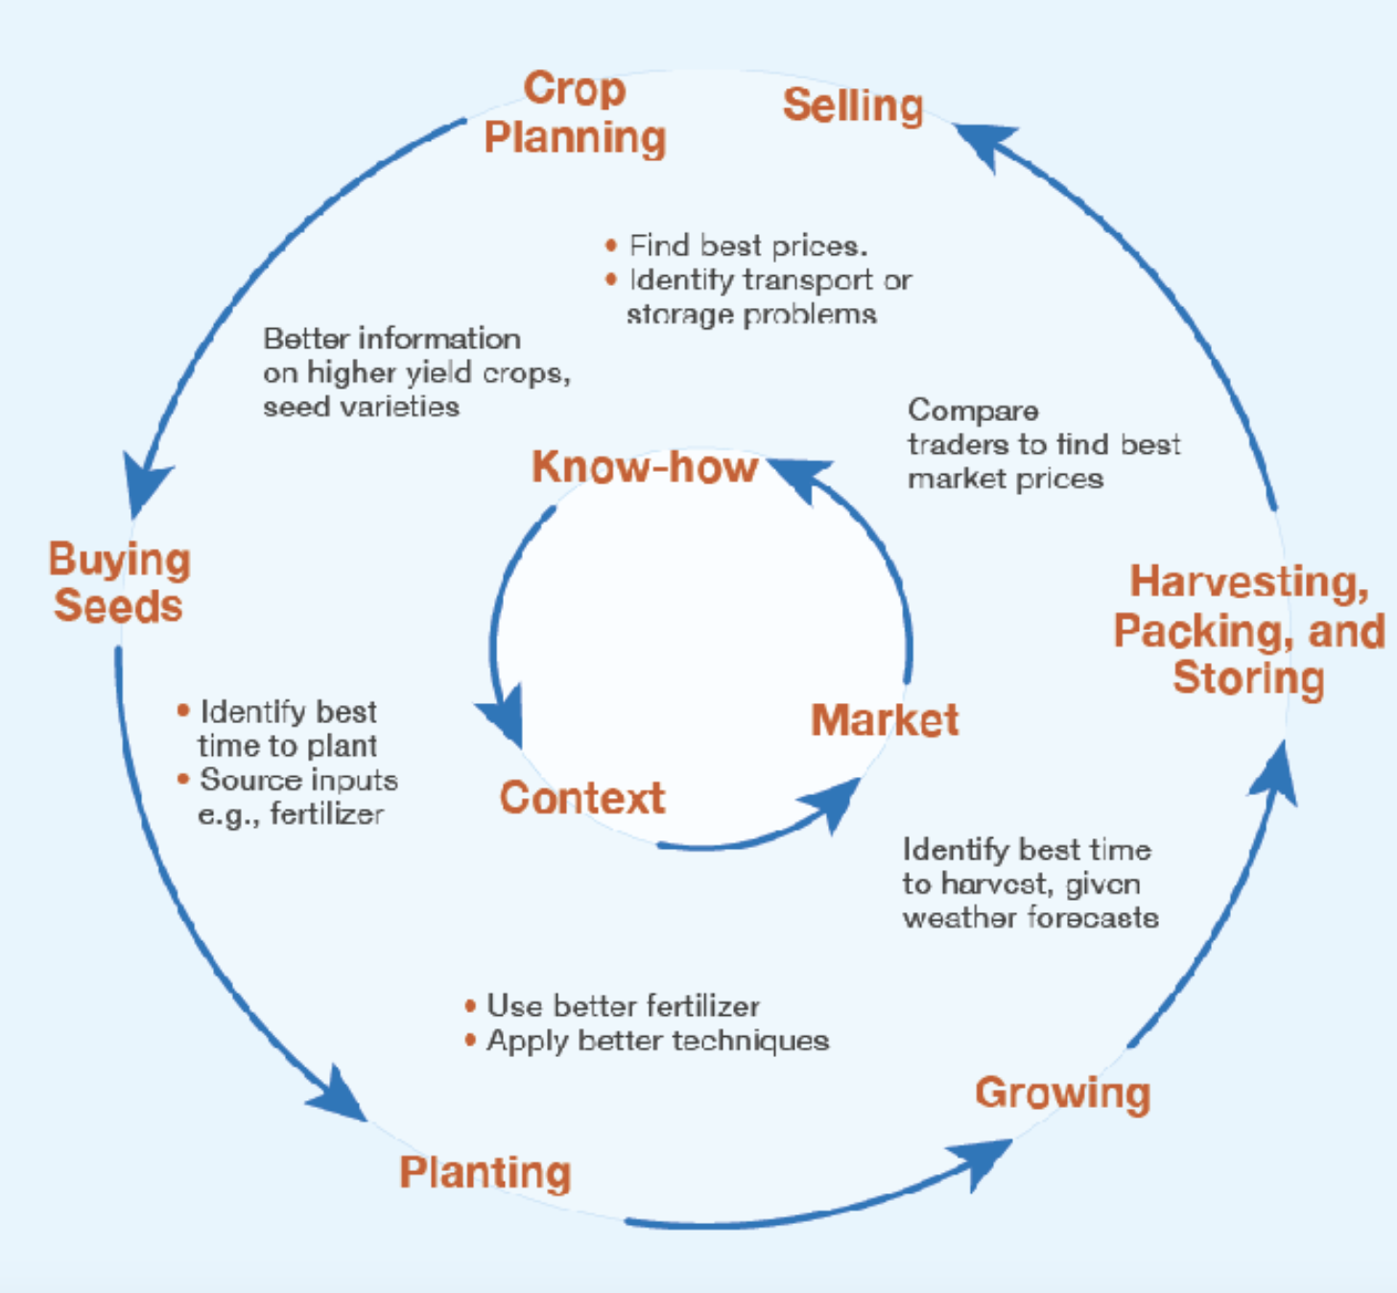

Today- Life of a farmer is not easy !
RV College of Engineering
What all should I focus on?
Image Credit : https://www.researchgate.net/figure/Information-needs-of-farmers-Adapted-from-Mittal-2010_fig1_301277058
https://www.gettyimages.ca/photos/farmer-india

Slide 9
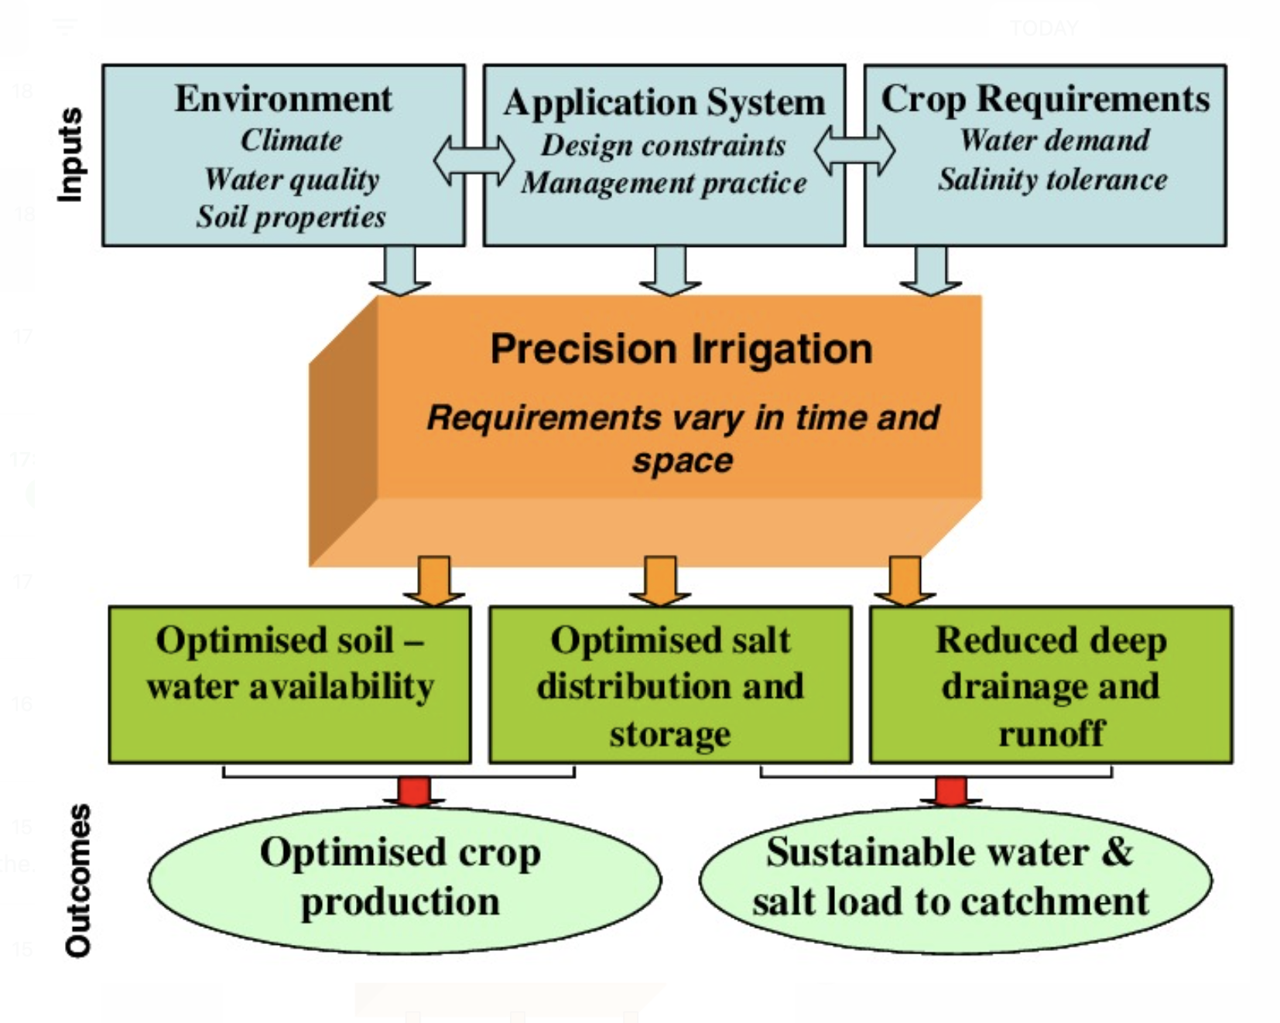

Today- Lets help him do better with Precision Agriculture
RV College of Engineering
Aha….I can start with one area and adopt others in phased manner
Image Credit :
https://www.gettyimages.ca/photos/farmer-india

Slide 10
RV College of Engineering
LITERATURE SURVEY
Go, Change the World
Author | Paper/Book Title | Publication Details | Summary
Mvungi, Abu | Physics and Chemistry of the Earth , Parts A/B/C | Published by Elsevier Ltd. Volume 30,Issues 11-16,2013 | The study obtained both quantitative and qualitative data. The major findings are that social, political, environmental and demographic bases that supported the traditional irrigation system have changed drastically. As a corollary to this, the cultural and religious belief systems that supported and guided the traditional canal system management have been replaced by mistrust and corruption in water allocation.
Yohannes Aberra | The Geographical Journal | The Royal Geographical Society Volume 170,Issue 3-2004 | The systems of headworks and canals are crude and wasteful on water. Recent interventions to improve the small-scale irrigation systems of the area have not been successful. Most interventions have preferred to introduce rainwater harvesting systems using micro-dams rather than trying to upgrade the traditional diversion schemes.

Slide 11
RV College of Engineering
LITERATURE SURVEY
Go, Change the World
Author | Paper/Book Title | Publication Details | Summary
Joe Henry Obit , Christie Pei-Yee Chin, Haviluddin Haviluddin, Yuto Lim | Towards Paddy Rice Smart Farming: A Review on Big Data, Machine Learning, and Rice Production Tasks | IEEE, Volume 9 Pages : 50358 - 50380 Published on - 29 March 2021 INSPEC Accession Number: 20966856 | Based on the proposed mapping framework, the conclusion is that an efficient and effective integration of all three technologies is very crucial that transform traditional rice cultivation practices into a new perspective of intelligence in rice precision agriculture. Finally, this paper also summarizes all the challenges and technological trends towards the exploitation of multiple sources .
Sudharshan N, AVS Kasturi Karthik,JS Sandeep Kiran, Geetha S | Renewable Energy Based Smart Irrigation System | Elsevier, Volume 165 Pages : 615-623 2019 | This research gives an idea of smart irrigation system. This irrigation system uses three sensors namely temperature sensor, humidity sensor and soil moisture sensor, and fuzzy logic is used to operate the solenoid valve. The data from the sensors is then sent to the cloud by using adafruit.io and the farmer can view the moisture level, humidity level and temperature recorded by these sensors.

Slide 12
RV College of Engineering
LITERATURE SURVEY
Go, Change the World
Author | Paper/Book Title | Publication Details | Summary
Abhilash Lad, Sumitra Nandre, Krishna Raichurkar, Sumit Zarkhande, Dr. Priya Charles | A Literature Survey on Smart Agriculture Monitoring and Control System Using IOT | Published by IJRASET ISSN : 2321-9653 Paper Id : IJRASET40512 | Agriculture provides a wealth of data analysis parameters, resulting in increased crop yields. For better crop growth moisture, mineral, light and other factors can be assumed. This research looks into a few of these characteristics for data analysis with the goal of assisting users in making better agricultural decisions using IoT. The technique is intended to help farmers increase their agricultural output.
Bam Bahadur Sinha, R. Dhanalakshmi | Recent advancements and challenges of Internet of Things in smart agriculture: A survey | Elsevier, Volume -126 Pages: 169-184 January 2022 | . Soil condition, irrigation water, herbicides and pesticides, weed control, and greenhouse output climate, may be tracked in smart agriculture to increase crop yields, minimize costs, and maintain process inputs. Smart agriculture and the use of reduced pesticides and fertilizers in crops will help to mitigate leaching issues and pollution, as well as the effects of climate change, in precision agriculture.

Slide 13
RV College of Engineering
MOTIVATION
Go, Change the World
Smart irrigation is a topic of great importance as it addresses a critical global issue: water conservation and management. With the world's population growing rapidly and demand for water increasing, it's crucial to find ways to optimize the use of this finite resource.
Smart irrigation systems use sensors, weather data, and advanced algorithms to adjust watering schedules and amounts, ensuring that crops receive the right amount of water at the right time. This results in more efficient use of water, which not only conserves this valuable resource but also leads to better plant health, growth, and productivity.
Another factor that has contributed to the increasing popularity of smart irrigation is the need for more sustainable and environmentally friendly farming practices. With the effects of climate change becoming increasingly apparent, it's more important than ever to adopt technologies that help reduce the carbon footprint of agriculture. Smart irrigation systems can help achieve this by reducing water waste and allowing for more precise water use.
Overall, smart irrigation is a timely and relevant topic with significant impacts on agriculture, water management, and the environment.

Slide 14
RV College of Engineering
OBJECTIVES
Go, Change the World
This project, an interdisciplinary approach to Smart Irrigation, aims to :
To design and develop a smart irrigation system that is able to optimize water use and conserve water resources.
To evaluate the efficiency and effectiveness of the smart irrigation system in terms of water savings, crop health and yield, and energy use.
To investigate the impact of smart irrigation on the environment, including water quality, soil health, and greenhouse gas emissions.
To explore the potential for integrating smart irrigation systems with other agricultural technologies, such as precision agriculture, remote sensing, and greenhouse automation.
To identify and address technical, economic, and social challenges associated with the implementation of smart irrigation systems.
To educate and raise awareness among farmers, policymakers, and the general public about the benefits of smart irrigation and the importance of water conservation and management.

Slide 15
METHODOLOGY OUTLINE
Assessment of soil and climate conditions: The first step is to understand the soil type, moisture content, temperature, and climate conditions of the area where irrigation is to be implemented. This will help in determining the watering needs of the plants and the amount of water that needs to be used.
Collection of data: Data on water usage, soil moisture levels, and weather patterns are collected using sensors, weather stations, and other monitoring equipment. The data is then transmitted to a central system for analysis.
Analysis of data: The data collected is analyzed to determine the optimal watering schedule for the plants. This includes taking into account the type of soil, weather conditions, and the water needs of the plants.
Control of irrigation system: Based on the analysis, the smart irrigation system automatically adjusts the watering schedule to match the needs of the plants. The system can be programmed to water at specific times, for specific periods, or based on the data collected.
Monitoring and evaluation: The system is monitored regularly to ensure that it is functioning optimally and to make any necessary adjustments. The system is also evaluated to determine its effectiveness in conserving water and improving plant growth.
Optimization: Over time, the system can be further optimized based on the data collected and the results achieved. This can include changes to the watering schedule, the types of sensors used, or the software algorithms used to control the system.

Slide 16
Chemistry Components Of Smart Irrigation
1. pH Monitoring: pH is one of the most important factors in soil fertility. Smart irrigation systems can monitor the pH levels of soil and adjust the irrigation accordingly.
2. Soil Moisture Monitoring: Smart irrigation systems can measure and monitor the moisture levels in the soil, and adjust the amount of water needed for optimal plant health. This involves using sensors to measure the water content of the soil, and the data collected can be used to determine when and how much water should be applied to the soil.
3. Nutrient Monitoring: Smart irrigation systems can monitor the nutrient levels in the soil and adjust irrigation accordingly. Nutrient application control involves using sensors to measure the nutrients in the soil, and the data collected can be used to determine when and how much fertilizer should be applied
4. Temperature Monitoring: Smart irrigation systems can measure the temperature of the soil and adjust the amount of water needed for optimal plant growth.
5. Salinity Monitoring: Smart irrigation systems can measure the salinity of the soil and adjust the amount of water needed for optimal plant health.

Slide 17
RV College of Engineering
Polymers In Smart Irrigation
Go, Change the World
Smart polymers are those that undergo rapid, reversible phase changes in response to small changes in environmental conditions.
They work when the protein to be separation forms a bioconjugate – a stable covalent link between the biomolecule and another molecule – with a polymer and precipitated with the polymer when the environment is changed.
Polymers that are used in drip irrigation include HDPE, LDPE, and LLDPE .
Example: Ista and Lopez employed poly(N-isopropylacryl-amide) (PNIPAAM), a polymer that is soluble in water below, but insoluble above, 32°C

Slide 18
RV College of Engineering
Polymers In Smart Irrigation
Go, Change the World
Smart irrigation technologies can also involve the use of water-soluble polymers to help retain water near the roots of plants.
These polymers absorb and store water in the soil, making it available to plants when needed.
The use of polymers can help to reduce the amount of water required for irrigation, as the water is released slowly into the soil.
Finally, smart irrigation technologies can also include the use of various control systems, such as valves and pumps, to regulate the flow of water. This helps to ensure that the right amount of water is being applied to the soil in the right areas

Slide 19
Importance Of Chemistry In Smart Irrigation
Water Quality: The water quality should be tested to determine the pH level, total dissolved solids (TDS), electrical conductivity (EC), and the presence of any contaminants such as salts, minerals, or heavy metals. This information is used to determine the suitability of the water for irrigation and to adjust the water quality as needed.
Soil Chemistry: The soil chemistry should be analyzed to determine the nutrient content, pH level, and the presence of any contaminants such as salts, minerals, or heavy metals. This information is used to determine the suitability of the soil for growing plants and to adjust the soil chemistry as needed.
Fertilizers: Fertilizers can be added to the irrigation water to provide the plants with the necessary nutrients for optimal growth. The type and amount of fertilizer used will depend on the specific requirements of the plants and the soil chemistry.
Chemicals: Certain chemicals, such as biocides, can be added to the irrigation water to control pests and diseases. The use of chemicals should be carefully monitored and regulated to ensure that they do not have a negative impact on the environment or the plants.

Slide 20
Go, change the world
RV College of Engineering
Department of Mathematics
EXPERIENTIAL LEARNING PRESENTATION
Course : Engineering Mathematics (22MA11C)
Topic :
PRECISION/SMART IRRIGATION
Submitted To :
DR. NIVYA MUCHIKEL
DEPT. MATHEMATICS
RVCE

Slide 21
MATHEMATICAL COMPONENTS OF SMART IRRIGATION
A real-time monitoring and auto-watering system based on predicting mathematical models that efficiently control the water rate is needed. It gives the plant the optimal amount of required water level, which helps to save water. It also ensures interoperability among heterogeneous sensing data streams to support large-scale agricultural analytics.
The mathematical model is embedded in the Arduino Integrated Development Environment (IDE) for sensing the soil moisture level and checking whether it is less than the pre-defined threshold value, then plant watering is performed automatically. The proposed system enhances the watering system’s efficiency by reducing the water consumption by more than 70% and increasing production due to irrigation optimization. It also reduces the water and energy consumption amount and decreases the maintenance costs.
The use of sensors helps to use water efficiently and reduce the water consumption and energy needed for irrigation, reducing the need for labor to turn the motor ON and OFF, controlled by the automated irrigation system based on renewable energy.

Slide 22
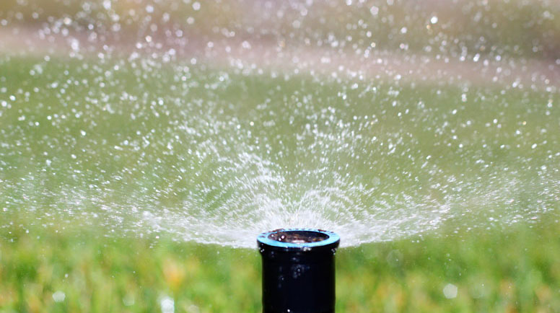
MATHEMATICAL COMPONENTS OF SMART IRRIGATION

Slide 23
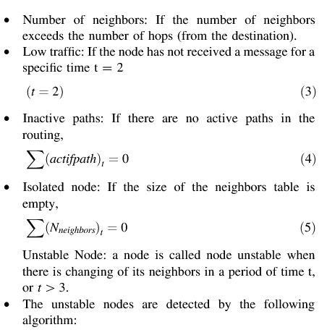
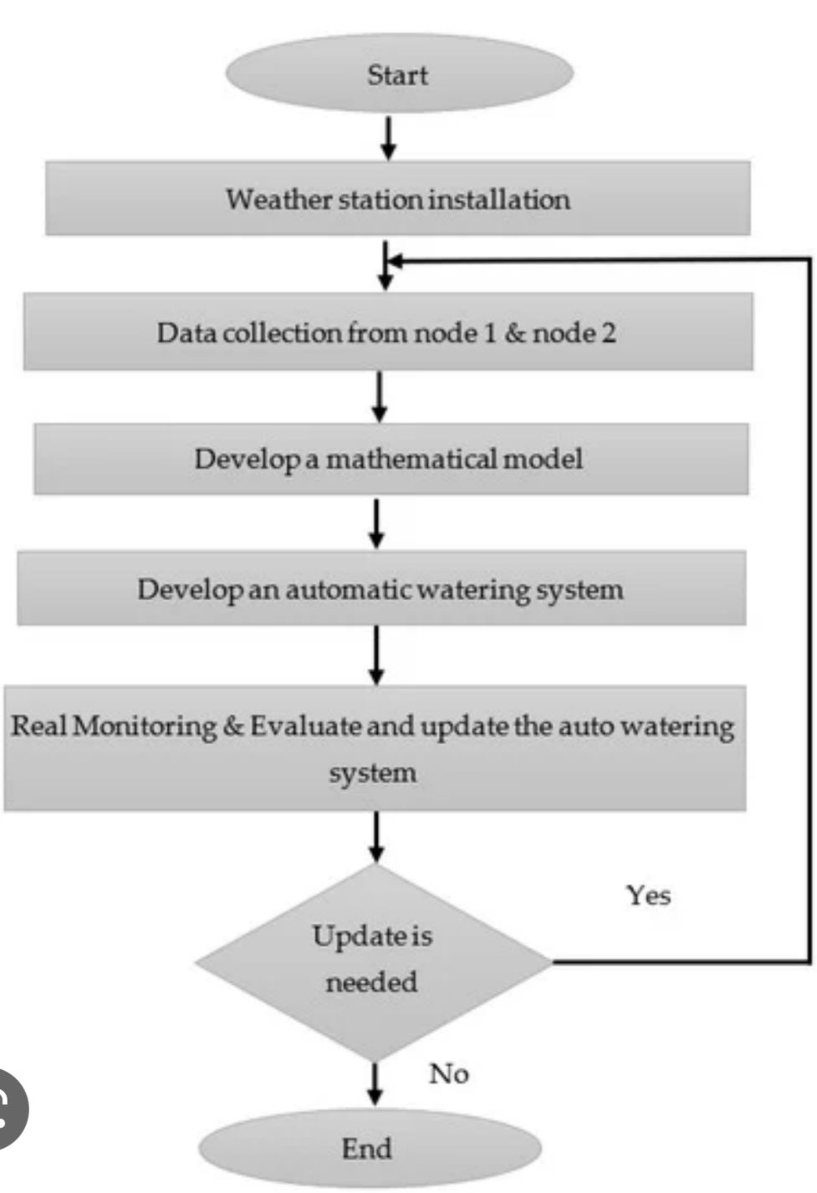
MATHEMATICAL COMPONENTS OF SMART IRRIGATION

Slide 24
Go, change the world
RV College of Engineering
Department of Electronics
EXPERIENTIAL LEARNING PRESENTATION
Course : Electronics Engineering (22ES14C)
Topic :
PRECISION/SMART IRRIGATION
Submitted To :
R SINDHU RAJENDRAN
DEPT. ELECTRONICS
RVCE

Slide 25
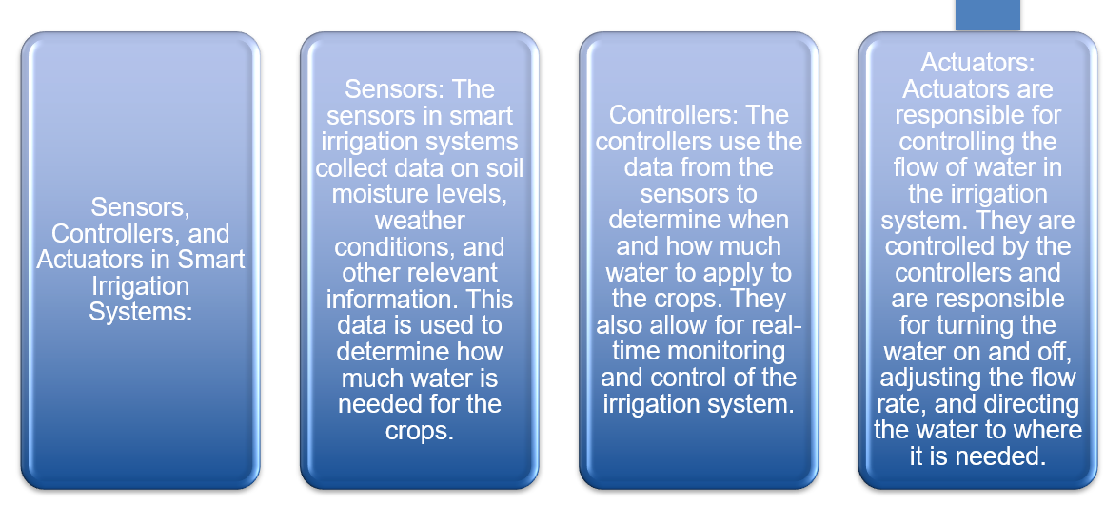
ELECTRONIC COMPONENTS OF SMART IRRIGATION

Slide 26
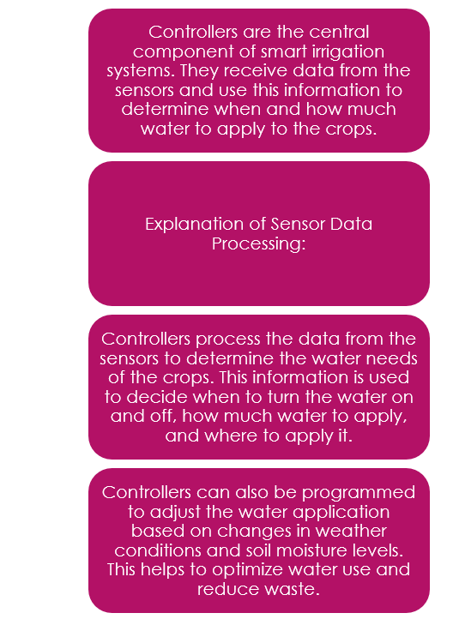
ELECTRONIC COMPONENTS OF SMART IRRIGATION

Slide 27
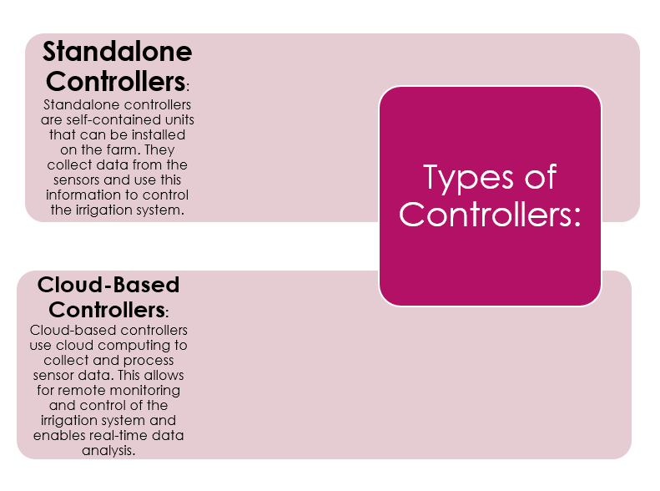
ELECTRONIC COMPONENTS OF SMART IRRIGATION

Slide 28
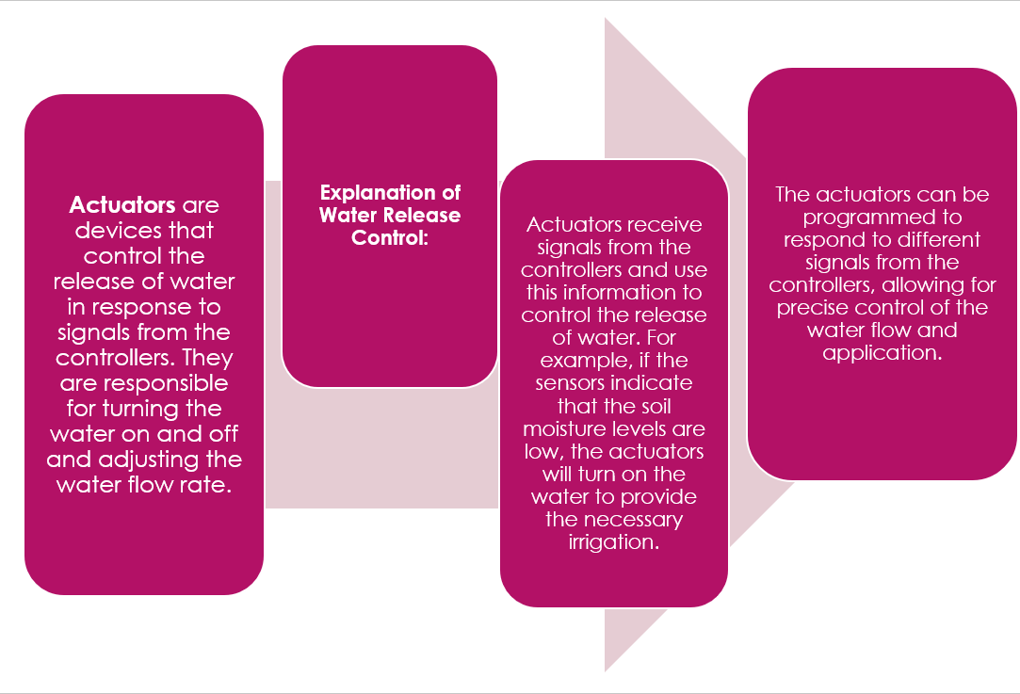
ELECTRONIC COMPONENTS OF SMART IRRIGATION

Slide 29
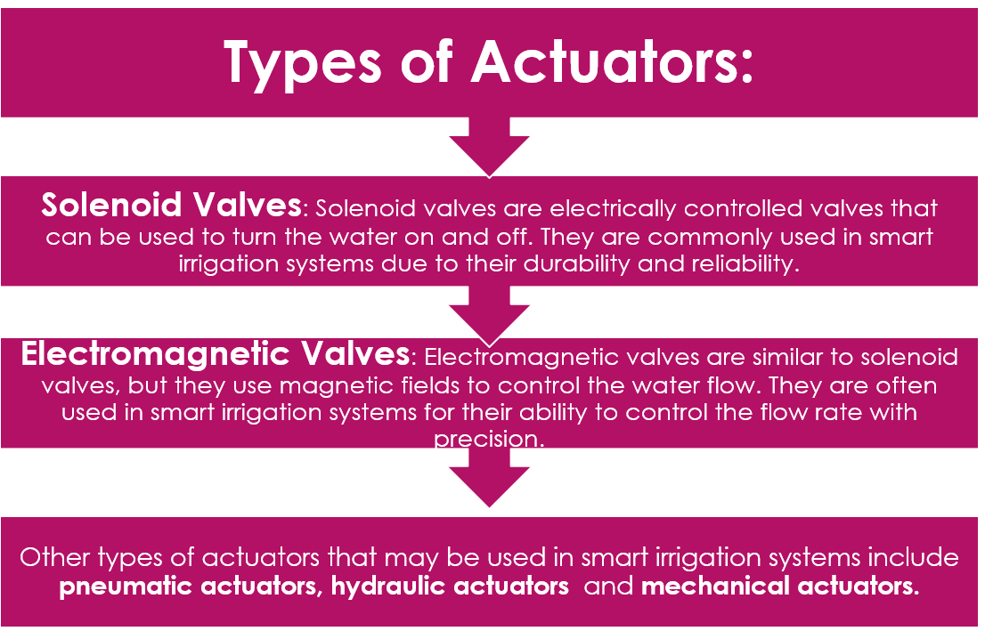
ELECTRONIC COMPONENTS OF SMART IRRIGATION

Slide 30
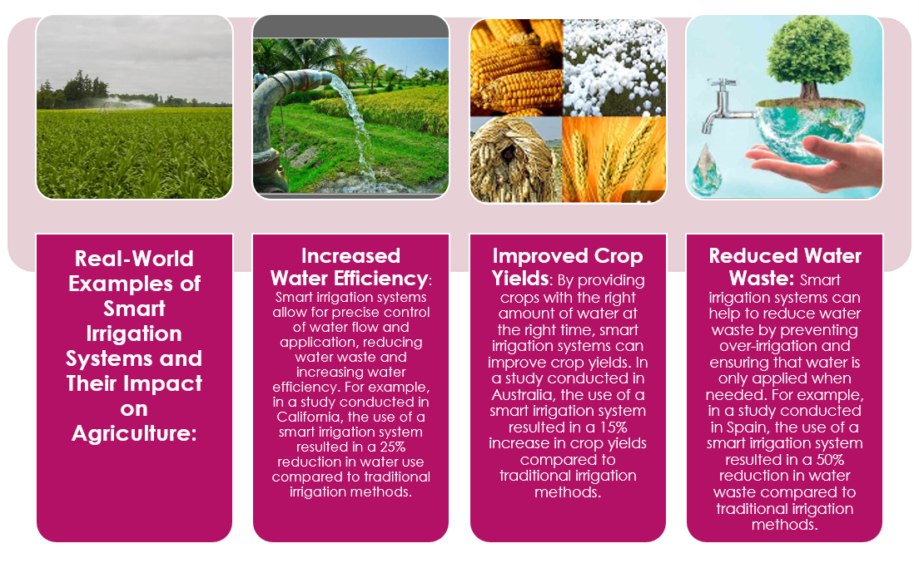
APPLICATIONS OF SMART IRRIGATION

Slide 31
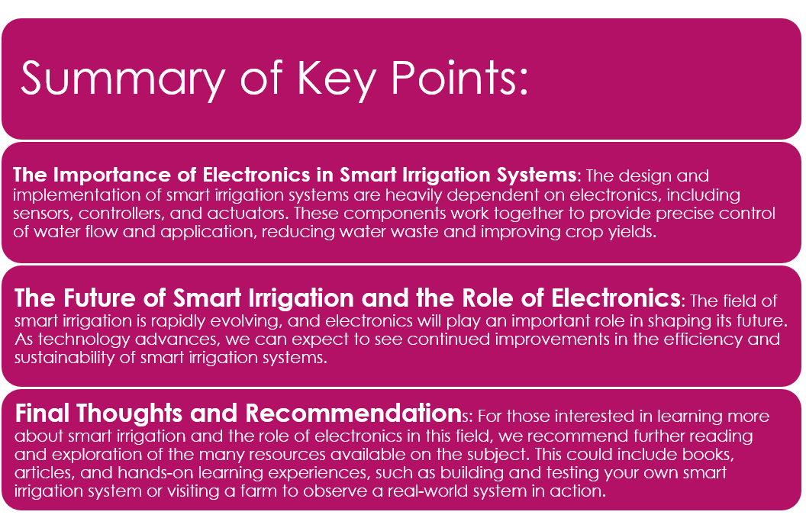
RV College of Engineering
SUMMARY
Go, Change the World

Slide 32
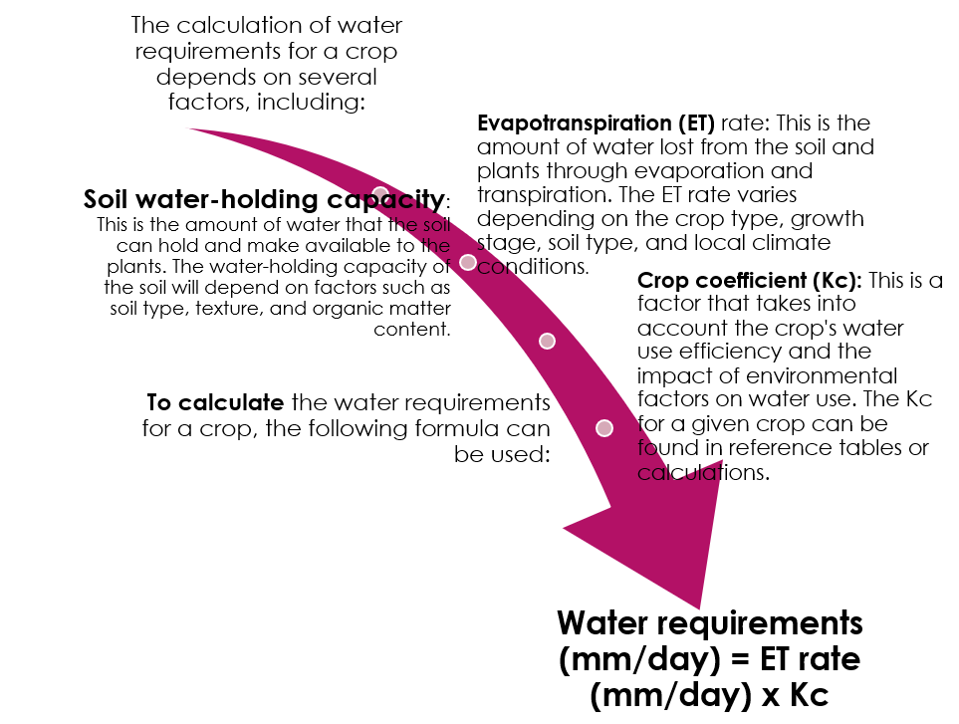
APPLICATIONS OF ELECTRONICS IN SMART IRRIGATION

Slide 33
DRAWBACKS
While smart irrigation systems have many benefits, there are also some potential drawbacks to consider:
Cost: Smart irrigation systems can be expensive to install and maintain, especially for large-scale operations. The cost of equipment, such as sensors and control systems, can be high, and there may also be ongoing costs for maintenance, software upgrades, and data analysis.
Technical Challenges: Smart irrigation systems require sophisticated technology and software to function effectively, and there can be technical challenges in ensuring that the system is working optimally. There may also be compatibility issues with existing systems, which can be time-consuming and expensive to resolve.
Maintenance: Regular maintenance and upkeep are required to ensure that the system is functioning optimally, and problems can arise if the system is not properly maintained. This can result in reduced efficiency and water waste.
Data Accuracy: The accuracy of the data collected by the sensors is crucial for the effective operation of a smart irrigation system. If the data is inaccurate, it can result in the plants receiving too much or too little water, which can negatively impact plant growth.
Reliance on Electricity: Smart irrigation systems rely on electricity to operate, which can be a problem in areas with limited or unreliable power supplies. This can result in system failures or reduced efficiency.
Limited Flexibility: Smart irrigation systems are designed to operate based on specific algorithms, which may not be suitable for all types of plants or soils. This can limit the flexibility of the system and reduce its effectiveness in certain conditions

Slide 34
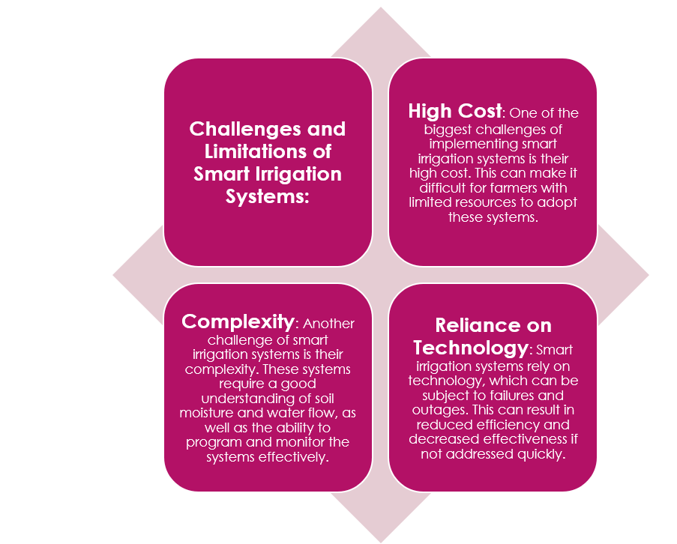
DRAWBACKS

Slide 35
Recommendation
Smart irrigation systems are a recommended solution for many agriculture and landscaping applications. The key benefits of smart irrigation systems include:
Water Conservation: Smart irrigation systems use water more efficiently and can reduce water waste by up to 50%. This is because the system is designed to provide the plants with the exact amount of water they need, based on real-time data.
Improved Plant Growth: By providing the plants with the right amount of water and nutrients, smart irrigation systems can improve plant growth and increase crop yields.
Cost Savings: By reducing water waste and improving plant growth, smart irrigation systems can help to lower operating costs and increase profitability.
Remote Monitoring: Smart irrigation systems can be monitored remotely, which allows for real-time monitoring of water usage and soil moisture levels. This makes it easier to identify potential issues and make adjustments to the system as needed.
Ease of Use: Smart irrigation systems are user-friendly and easy to operate, making them accessible for farmers and landscapers of all skill levels.

Slide 36
TIMELINE
RV College of Engineering
TIMELINE
Go, Change the World
Phase 1:
Phase 2:
Phase 3:
Phase 4:
Identified problem
Statement
Conducted literature reviews.
Acquired knowledge
For achieving
Objective.
Detailed explanation on the use of Smart Irrigation in Agriculture and a relevant model.

Slide 37
RV College of Engineering
REFERENCES
Go, Change the World
Mvungi, Abu ,Physics and Chemistry of the Earth , Parts A/B/C. Published by Elsevier.Ltd. Volume 30,Issues 11-16,2013
https://www.researchgate.net/publication/335037105_Superabsorbent_Polymers-
A_Potential_Solution_for_Irrigation_in_Agriculture/citation/download
Yohannes Aberra, The Geographical Journal ,The Royal Geographical Society , Volume 170, Issue 3-2004
Joe Henry Obit , Christie Pei-Yee Chin, Haviluddin Haviluddin, Yuto Lim, Towards Paddy Rice Smart Farming: A Review on Big Data, Machine Learning, and Rice Production Tasks
IEEE, Volume 9.
Bam Bahadur Sinha, R. Dhanalakshmi
Recent advancements and challenges of Internet of Things in smart agriculture: A survey
Elsevier, Volume -126

Slide 38
RV College of Engineering
REFERENCES
Go, Change the World
1. Sakar, S. K., Basavaraju, T. G., & Puttamadappa, C. (2008). Principles protocols, and applications, ad hoc mobile wireless networks. London: Taylor & Francis Group.
2. Wan, Z., Xiong, N., & Yang, L. T. (2015). Cross-layer video transmission over IEEE 802.11e multihop networks. Multimedia Tools and Applications,74(1), 5–23.
3. Perkins, C. E., & Royer, E. M. (1999). Ad-hoc on-demand distance vector routing. In Proceeding of IEEE Workshop on Mobile Computing Systems and Applications (WMCSA) (pp.1–11).
4. Ramrekha, A., & Talooki, V. C. (2010). Energy efﬁcient and scalable routing protocol for extreme emergency ad hoc communications. Mobile Networks and Applications, 17(2), 312–324. doi:10.1007/s11036-011-0336-0.
5. Jiang, M., Li, J., & Tay, Y. (1999). Cluster based routing protocol (CBRP) functional specication, internet draft. MANET working group.
6. Han, K., et al. (2013). Algorithm design for data communications in duty-cycled wireless sensor networks: A survey. IEEE Communications Magazine,51(7), 107–113.
7. Li, M., et al. (2013). A survey on topology control in wireless sensor networks: Taxonomy, comparative study, and open issues. Proceedings of the IEEE,101(12), 2538–2557.
8. Xiang, L., et al. (2011). Compressed data aggregation for energy efﬁcient wireless sensor networks. In SECON-IEEE communication society (pp. 46–54).
9. Chilamkurti, N., et al. (2009). Cross-layer support for energy efﬁcient routing in wireless sensor networks. Journal of Sensors, 2009, 134165. http://dx.doi.org/10.1155/2009/134165.

Slide 39
Thank You

